Slide 1
False Data Injection Attacks on the Internet of Things and Deep Learning Enabled Analytics
Harrison Faure | z5364422

Slide 2
Research Plan and Objectives
Overview:
Industry 4.0 merges automation with advanced manufacturing, aiming to reduce human effort and resources.
PdM uses data analysis tools and techniques to predict equipment failures before they occur and detect anomalies, making it an advanced strategy for maintenance. [1]

Slide 3
Research Plan and Objectives
Research Question
How do IoT sensor attacks, specifically False Data Injection Attacks (FDIA), impact the performance of deep learning (DL) models used in PdM systems for predicting the Remaining Useful Life (RUL) of turbofan engines?
Objectives
Implement various DL models (LSTM, GRU, CNN, RNN, Transformer).
Predict RUL using NASA’s C-MAPSS dataset.
Evaluate models under FDIA scenarios.
Propose a cybersecurity framework for PdM systems.

Slide 4
Literature Review
Key Points:
Industry 4.0 and PdM:
Industry 4.0 is a pivot in industrial production pioneered by the integration of digital technologies into manufacturing environments.
PdM uses data analysis tools and techniques to predict equipment failures before they occur, making it an advanced strategy for maintenance. [1]
Vulnerabilities in IoT and DL systems:
Having devices connected to the IoT exposes industrial networks to a variety of cybersecurity attacks, such as FDIA, which involve the injection of malicious data. [5]

Slide 5
Literature Review
Previous research gaps:
The majority of the published literature focuses on the accuracy of IoT and DL-enabled PdM systems and often ignores the effect of such attacks.
There is a significant gap in understanding how cyber-attacks, specifically FDIA, impact the reliability and accuracy of PdM systems.
Existing studies predominantly emphasize enhancing model accuracy and predictive capabilities without addressing the susceptibility to data integrity attacks.
Research is needed to develop robust PdM systems that maintain high predictive accuracy even in the presence of cyber threats.
DL models:
LSTM and GRU are effective in handling sequential data and long-term dependencies. [9]
CNNs are useful for extracting spatial hierarchies from time series data. [11] RNNs are beneficial for dynamic and complex fault detection scenarios common in PdM applications. [9]
Transformer models offer better performance in situations where long-range dependencies are crucial. [27]

Slide 6
Literature Review
Research Objectives:
My research addresses these gaps by evaluating the impact of FDIA on various DL models used in PdM systems for predicting the RUL of turbofan engines using NASA's C-MAPSS dataset. The goal is to propose a cybersecurity framework that enhances the resilience of PdM systems against FDIA attacks.

Slide 7
Methodology
Model selection and training:
Selected models: CNN, RNN, LSTM, GRU, and Transformers for their capabilities in handling time series data.
Working on also deploying explainable AI platform to detect and explain attack data in conjunction with PHD student Alaa Selim.
Data preparation:
Key steps: normalization, feature engineering, and handling missing values.
Possible data generation via creation of our own model in conjunction with Alaa Selim

Slide 8
Methodology
Implementation of advanced models:
CNN for spatial hierarchies, LSTM and GRU for long-term dependencies, RNN for sequential data processing, Transformers for long-range interactions.
FDIA attack simulation:
Simulate models under normal and FDIA attack scenarios.
Performance evaluation:
Metrics: RMSE, MSE, accuracy to RUL.
Resilience tests for robustness comparison.

Slide 9
Methodology
Iterative improvement and feedback:
Focus on optimization and refinement of algorithms.
Continuous feedback loop for improvements.
Drafting recommendations and framework:
Develop recommendations for enhancing PdM systems.
Draft a preliminary cybersecurity framework.

Slide 10
Data Collection and Analysis
The dataset includes various sensor data and operational settings from a NASA turbofan engine.
Data Pre-processing Steps:
Normalization
Feature engineering
Handling missing values
Future data collection and analysis steps:
FDIA simulation
Model evaluation under attack scenarios

Slide 11
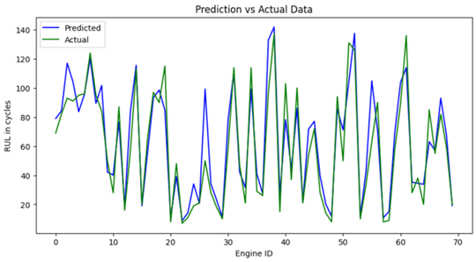
Preliminary results of CNN implementation:
MAE: 11.03
R²: 0.8314
LSTM and GRU:
Both LSTM and GRU are predicting a constant RUL.
Plan to fix: Adjusting model parameters and re-evaluating training processes.
Significance:
Demonstrates the potential of CNN for accurate RUL prediction.
Highlights the model's ability to capture complex patterns in the data.
Improvement:
Enhance model accuracy.
Resolve issues with LSTM and GRU models.
Implement FDIA resilience testing.
Preliminary Results

Slide 12
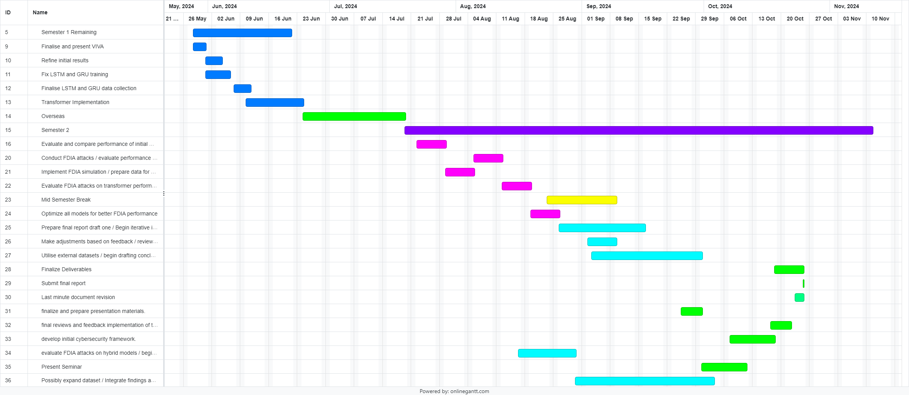
Timeline and Approach
Completed
Investigated current and past research to direct approach.
Researched pre-processing steps
Trained initial model generated reporting.
Possible Extensions:
Real-time data simulation
Working on explainable AI implementation with Alaa Selim.
Advanced anomaly detection techniques
Development of a comprehensive cybersecurity framework

Slide 13
Q & A

